Slide 1



DB Apps Introduction
How to connect to a database?
Databases
Frameworks
SoftUni Team
Technical Trainers
Software University
http://softuni.bg

Slide 2

Table of Content
ORM Introduction
JDBC Essentials

Slide 3
Questions
sli.do #Hibernate

Slide 4

ORM Intro

Slide 5
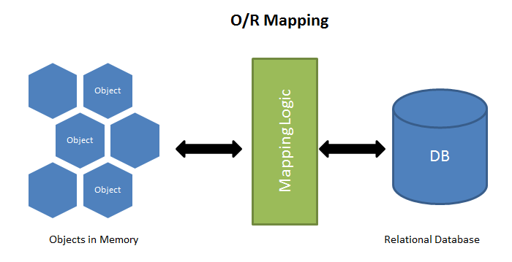
ORM Frameworks – Overview
ORM Frameworks map OOP classes to database tables

Slide 6
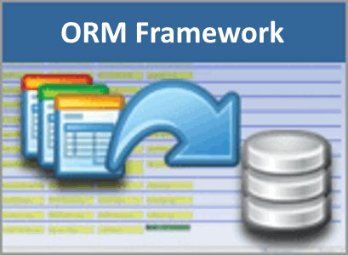
ORM Frameworks – Features
C# / Java / PHP classes are mapped to DB tables
DB relationships are mapped to class associations
ORM provides API for CRUD operations
List objects / query database
Create new object
Update existing object
Delete existing object
Some ORMs provide schema synchronization (DB migrations)
CRUD operations execute
SQL commands in the DB

Slide 7




Mapping DB Tables to Classes
students
id: INT name: VARCHAR(50) birth_date: Date major_id: INT
Student
id: int name: String birthDate: Date major: Major
ORM
Framework
majors
id: INT name: VARCHAR(50)
Major
id: int name: String students: List<Student>

Slide 8
Entity Class: Student
Student.java
@Entity @Table(name = "students")
public class Student {
@Id
@GeneratedValue(strategy = GenerationType.IDENTITY)
@Column(name = "id")
private int id;
@Column(name = "name", length = 50)
private String name;
@Column(name = “birth_date")
private Date birthDate;
@ManyToOne(optional = false)
private Major major;
}
Set table name
Primary key
Identity
Column name
Column name + length
Column name
Student
id: int name: String birthDate: Date major: Major
Mapping

Slide 9
Entity Class: Major
Major.java
@Entity
@Table(name = "majors")
public class Major {
@Id
@GeneratedValue(strategy = GenerationType.IDENTITY)
@Column(name = "id")
private int id;
@Column(name = "name", length = 50)
private String name;
@OneToMany(mappedBy = "major")
List<Student> students; }
Set table name
Primary key
Identity
Column name
Column name + length
Major
id: int name: String students: List<Student>
Mapping

Slide 10

JPA – Java Persistence API
Persistence
import javax.persistence.*;
==
JPA
createEntityManagerFactory()
Query
EntityManagerFactory
setParameter()
getResultList()
getSingleResult()
executeUpdate()
Entity
Entity
Entity
createEntityManager()
id
field1
field2
id
field1
field2
id
field1
field2
EntityManager
EntityTransaction
getTransaction()
find() / createQuery()
persist()
remove()
begin()
commit()
rollback()

Slide 11
Class: Demo
public static void main(String[] args) {
EntityManagerFactory entityManagerFactory = Persistence.createEntityManagerFactory("school");
EntityManager entityManager = entityManagerFactory.createEntityManager();
Student student = new Student();
student.setName("John");
student.setDate(new Date());
Major major = new Major();
major.setName("Software Engineering");
student.setMajor(major);
entityManager.getTransaction().begin();
entityManager.persist(major);
entityManager.persist(student);
entityManager.getTransaction().commit();
}
Manager factory
Persistence unit from persistence.xml
Entity manager
Create Objects
Persist Objects

Slide 12

JDBC Essentials

Slide 13
Java Database Connectivity (JDBC)
JDBC is a standard Java API for database-independent connectivity between the Java programming language and a wide range of databases.
The JDBC library includes APIs for each of the tasks mentioned below that are commonly associated with database usage:
Making a connection to a database.
Creating and executing SQL queries in the database.
Viewing & Modifying the resulting records.

Slide 14
JDBC Architecture
APP
JAVA.SQL.*
DRIVER
JDBC
MySQL Oracle PostgreSQL
SQL Server
RDBMS

Slide 15
Driver specifics
JDBC Connection String jdbc:<driver protocol>:<connection details>
JDBC URL
Database | JDBC URL
MySQL | jdbc:mysql://localhost
Oracle | jdbc:oracle:thin:@localhost
SQL Server | jdbc:sqlserver://localhost
PostgreSQL | jdbc:postgresql://localhost

Slide 16

Driver Download
MySQL Connector/J
https://dev.mysql.com/downloads/connector/j/

Slide 17
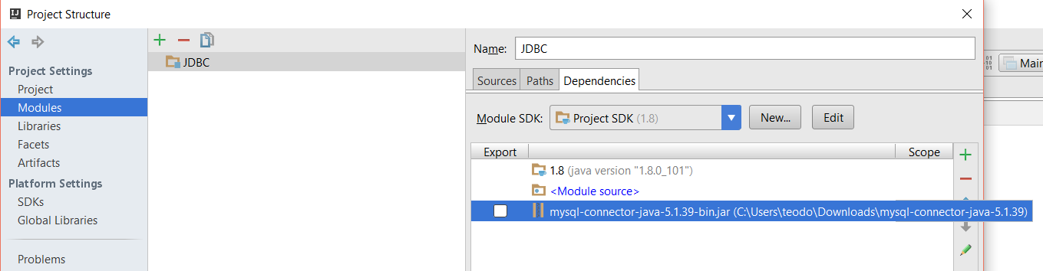
Setup Driver
IntelliJ

Slide 18
Connection Verification
package com.company;
import java.sql.*;
public class Main {
private static final String URL = "jdbc:mysql://localhost:3306/sys";
//Replace with your user name
private static final String USER = "root";
//Replace with your password
private static final String PASSWORD = "1234";
public static void main(String[] args) {
try {
Connection connection = DriverManager.getConnection(URL, USER, PASSWORD);
System.out.println("The connection is successful! Well done bro!");
} catch (SQLException e) {
e.printStackTrace();
}
}
}
JDBC URL
USER
PASS
Connection

Slide 19
java.sql.*
DriverManager
Connection
Statement
ResultSet

Slide 20
JDBC Statement Retrieve Data
JDBC URL
public static void main(String[] args) {
try {
Connection connection = DriverManager.getConnection(URL, USER, PASSWORD);
Statement statement = connection.createStatement();
String sql = "SELECT * FROM students";
ResultSet resultSet = statement.executeQuery(sql);
while(resultSet.next()){
int id = resultSet.getInt("id");
String name = resultSet.getString("name");
System.out.println(String.format("%d, %s",id, name));
}
} catch (SQLException e) {
e.printStackTrace();
}
}
Statement
SQL
Fetch Results
Result Set

Slide 21

Summary
Popular ORM
JDBC Essentials

Slide 22









JDBC
https://softuni.bg/courses/

Slide 23
SoftUni Diamond Partners

Slide 24
License
This course (slides, examples, demos, videos, homework, etc.) is licensed under the "Creative Commons Attribution-NonCommercial-ShareAlike 4.0 International" license
Attribution: this work may contain portions from
"Databases" course by Telerik Academy under CC-BY-NC-SA license

Slide 25





Free Trainings @ Software University
Software University Foundation – softuni.org
Software University – High-Quality Education, Profession and Job for Software Developers
softuni.bg
Software University @ Facebook
facebook.com/SoftwareUniversity
Software University @ YouTube
youtube.com/SoftwareUniversity
Software University Forums – forum.softuni.bg

